Slide 1
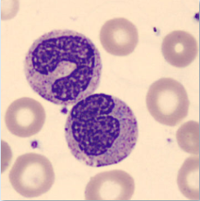
Capstone
Computer Vision and using Edge Detection as a Fourth Channel
ISU Business Analytics Spring 2021
Kristina Mishra
Notes:
2016, an old boss came to be and asked if I would join his company. He needed a data person and after
I accepted, I was immediately put on a project that created an end-to-end solution to store the Nigeria’s HIV patient data into one system and build some analytics with it.
We completed and handed the system over to the Ministry of Health. A little while later, one of the stakeholder’s told us that our work was helping them pinpoint the exact time you have to start medication for HIV positive pregnant woman, so that her unborn child does not get infected.
After that I was hooked. And it really showed me the power that analytics have to help change the world.
HIV/malaria/etc
Give my background/passion
2.)Acevedo, A. et al. (2020) ‘A dataset for microscopic peripheral blood cell images for development of automatic recognition systems’, 1. doi: 10.17632/snkd93bnjr.1.

Slide 2
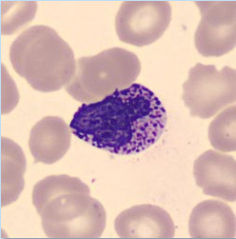
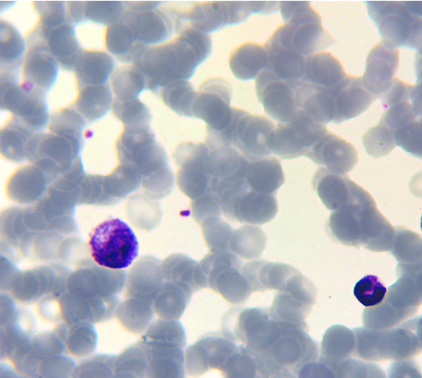
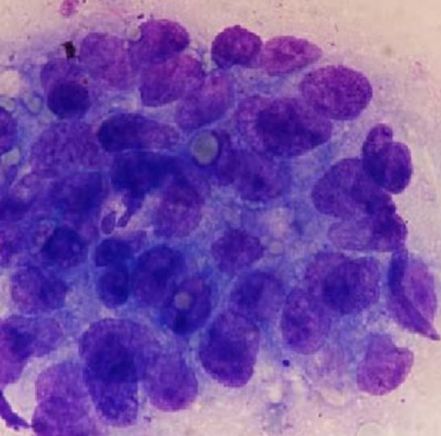
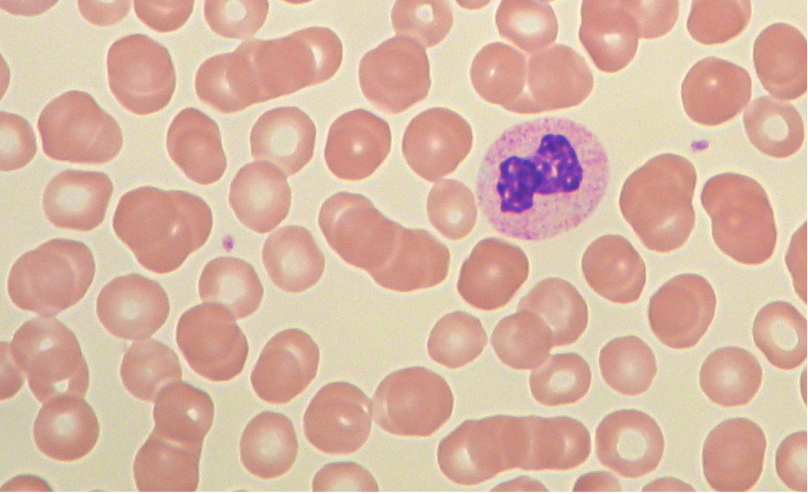
Overlapping Objects
Improving detection and classification of blood cells
Notes:
World Economic Forum, says that healthcare is one of the top 5 global problems AI can help us solve.
Computer vision is AI applied to the visual world.
How would you count these cells?
How would you identify if they have a marker for disease?
One of the ways it is addressed in healthcare is by examining blood cells. From a global perspective, computer vision offers a way to not only improve accuracy from fatigued staff, but also to offer a lower cost solution for communities that can afford things such as lab equipment.
Dr. Martial Hebert, Dean of the School of CS at CMU.:
reliably detect occluding boundaries
This isn’t just limited to blood cells – agriculture uses it to identified disease in things like maize or barley
Driverless car technology needs it to identify objects all around, like people walking in a group together.
1.)Detecting & Using Object Boundaries (no date). Available at: http://www.cs.cmu.edu/~stein/nsf_webpage/ (Accessed: 5 May 2021).
1.) 5 global problems that AI could help us solve (no date) World Economic Forum. Available at: https://www.weforum.org/agenda/2017/02/5-global-problems-that-ai-could-help-us-solve/ (Accessed: 2 May 2021).

Slide 3
Opportunity
Data
Model
Results
Cleansing
Augmenting
Split
Make More
SegNet
HED
Integrated
Record
Evaluate
Make More
Notes:
Notes:
Creating an end-to-end process that can also be divided into sep pieces
Tie to costs
Object detection and classification problem
Create a low cost end-2-end solution to see if we can improve accuracy.
2 fold:
system that is breakable into parts so stakeholder can pick and choose
Verify if this idea is even helpful

Slide 4
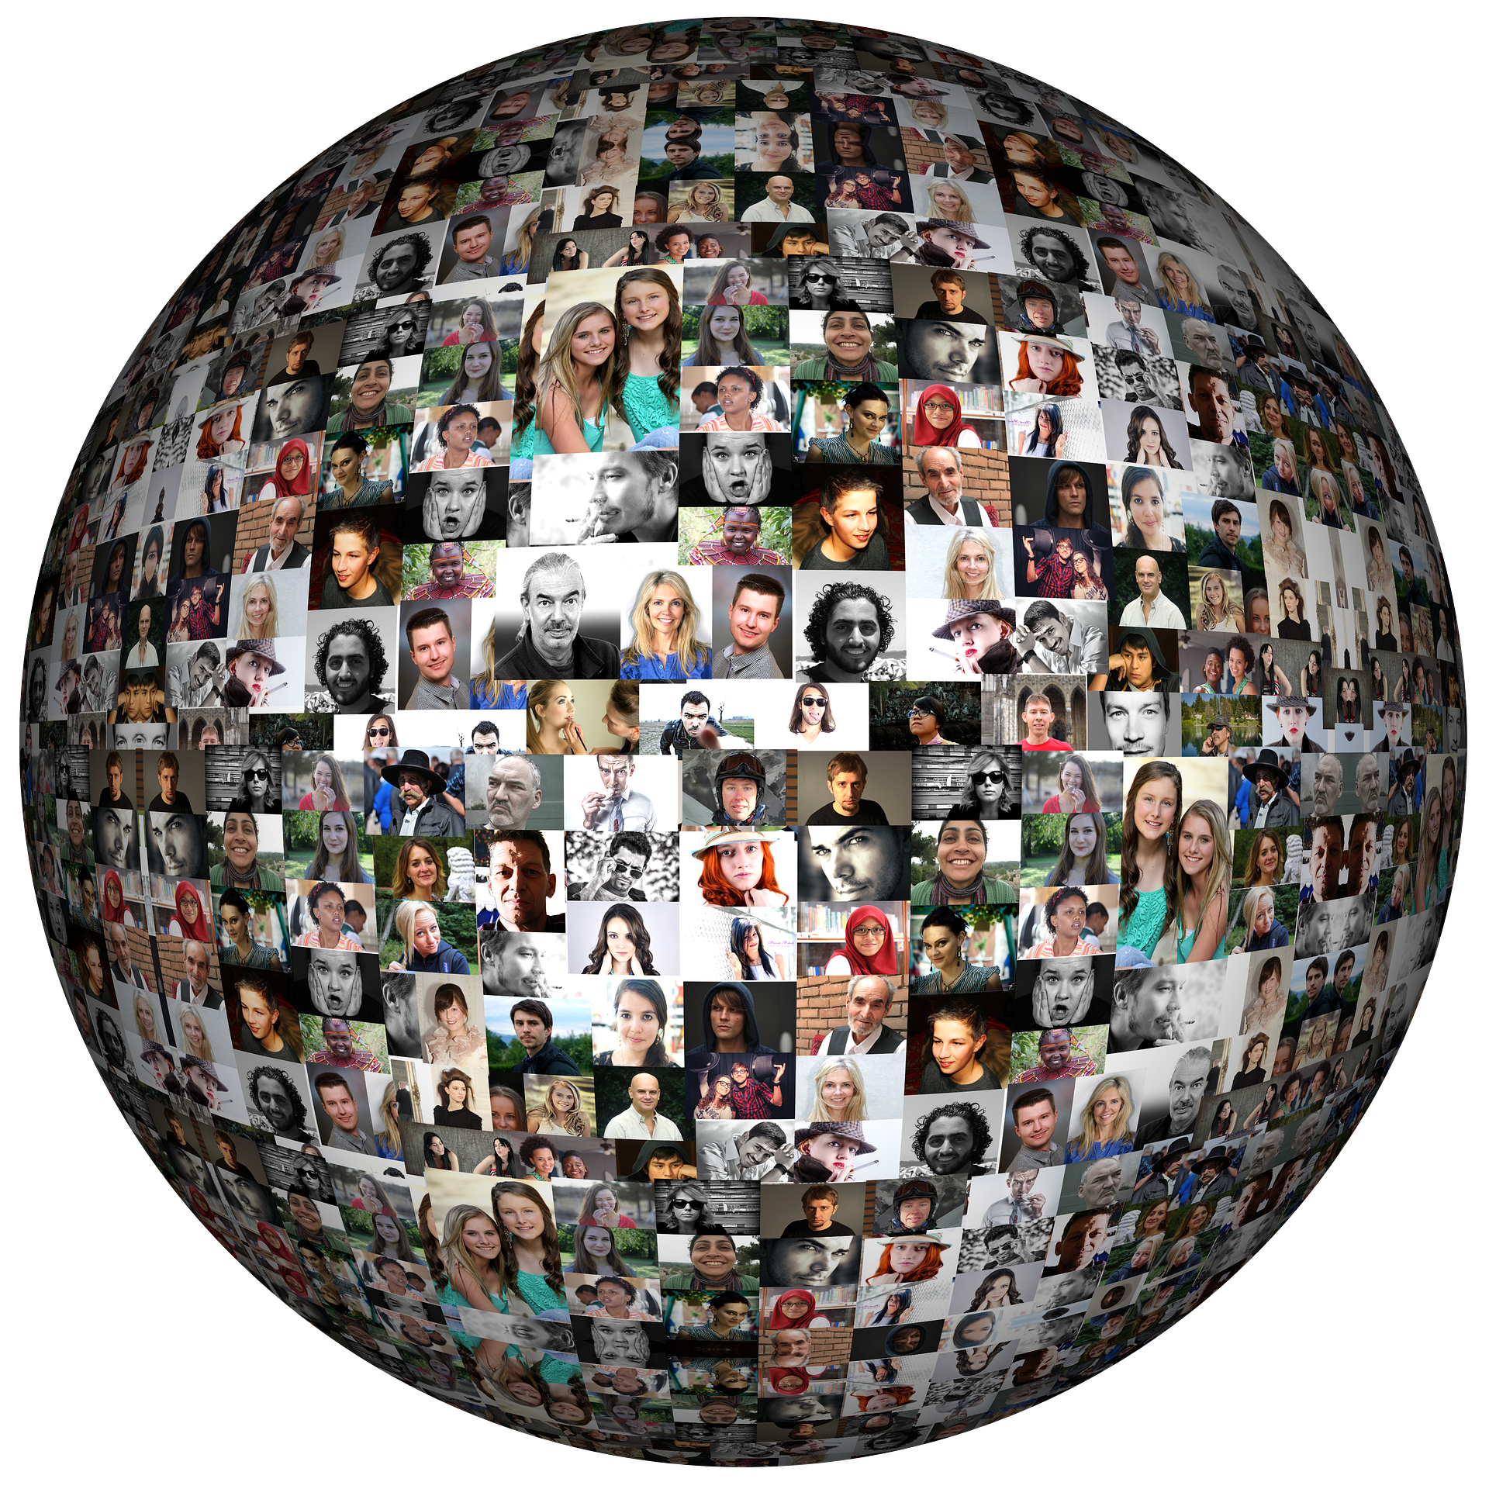
Benefit
Who: global community
What: medical research, agriculture, academics
Notes:
laboratory professionals, agricultural companies, healthcare informatics companies, researchers, health professionals, data scientists, students, small companies newly entering the computer vision space, and the Iowa State University Master of Business Analytics Capstone Committee.
The facebook 2019 Computer Vision for Global Challenges research 3 awards:
An early warning system for crop diseases
2 different projects for analyzing blood smears for malaria
Computer Vision for Global Challenges research award winners (no date). Available at: https://ai.facebook.com/blog/announcing-the-winners-of-the-computer-vision-for-global-challenges-research-awards/ (Accessed: 2 May 2021).

Slide 5
Key Terms
Ground truth
Annotation
Contour

Slide 6
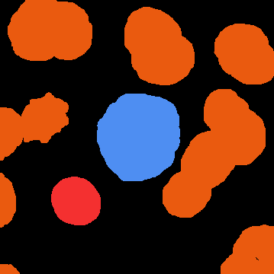
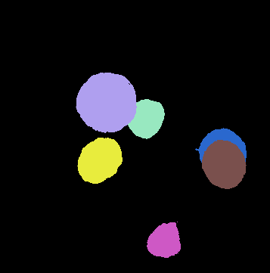
Segmentation
Notes:
Sematic segmentation (image)
Instance segmentation
2019 IEEE 16th International Symposium on Biomedical Imaging , Bohm, Tatorchenko, and Falk, like many other researchers before, presented works showing that semantic segmentation is better for cell research that has overlapping objects.
Böhm, A., Tatarchenko, M. and Falk, T. (2019) ‘ISOOV2 DL - Semantic Instance Segmentation of Touching and Overlapping Objects’, in 2019 IEEE 16th International Symposium on Biomedical Imaging (ISBI 2019). 2019 IEEE 16th International Symposium on Biomedical Imaging (ISBI 2019), pp. 343–347. doi: 10.1109/ISBI.2019.8759334.

Slide 7
Goals: Defining Success
Expected
Aspirational
Develop framework
Test multiple models
Communicate results
Increase accuracy by 5%
ResNet/U-Net
Synthetic dataset
Transfer learning
Notes:
Measure success: overall accuracy and loss, mean accuracy
Min: develop framework
Exp: best prac – splits of data
Aspirational:
inc acc for all cells 5%
Build stronger base network (ResNet or U-Net)
Transfer learning
Synthetic set
Patch-based sliding window

Slide 8
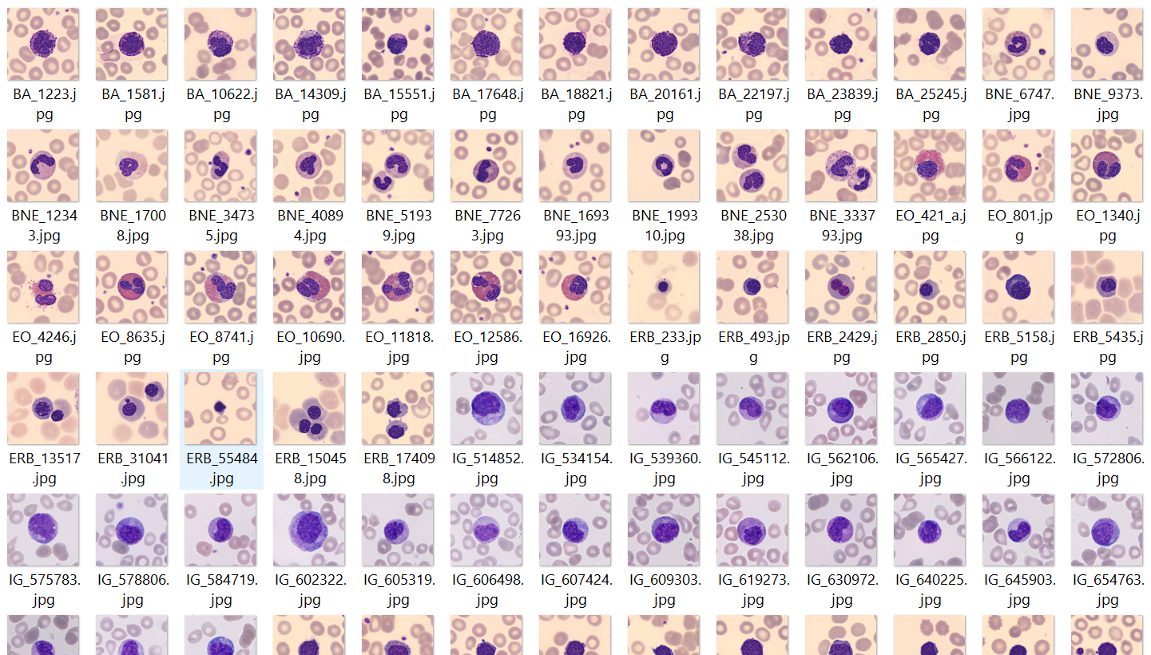
Dataset
Notes:
This project used microscopic peripheral blood cell images from the Hospital Clinic of Barcelona to test if adding an edge as a fourth channel to an image would improve results
The dataset was annotated by expert clinical pathologists and organized into eight groups:
neutrophils
Eosinophils
basophils
lymphocytes
monocytes
immature granulocytes
erythroblasts
platelets

Slide 9
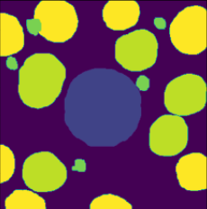
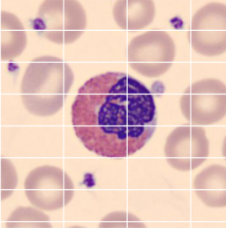
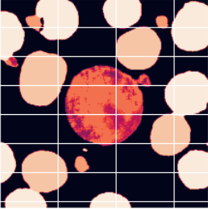
SegNet Architecture
Down
sample
Convolution
2 layers
64 channels
MA X
P
O
O
L
Conv
2 layers
128 channels
MAXP
O
O
L
Conv
3 layers
256 channels
MP
O
O
L
Conv
3 layers
512 channels
MP
Conv
3 layers
512 channels
MP
Soft
max
Up
sample
Convolution
2 layers
64 channels
MA X
UN
P
O
O
L
Conv
2 layers
128 channels
MXUNP
O
O
L
Conv
3 layers
256 channels
MUP
O
O
L
Conv
3 layers
512 channels
MU
P
Conv
3 layers
512 channels
MU
P
Notes:
Developed in 2016 and the official paper: SegNet: A Deep Convolutional Encoder-Decoder Architecture for Image Segmentation published in 2017.
Has 1522 paper citations, and 102235 full text views on IEEE Explore.
Since the network does not have any fully connected layers (which consume >90% of the parameters in a typical image processing CNN) it is much lighter.
SEGNET is thus very memory efficient and comparatively easy to train. * (Classification with an edge: Improving semantic image segmentation with boundary detection,, Marmanis, 2018)
Max-pooling layers are replaced by unpooling, where the values are restored back to their original location, then convolution layers interpolate the higher-resolution image.
Softmax - function outputs a vector that represents the probability distributions of a list of potential outcomes
1.) Badrinarayanan, V., Kendall, A. and Cipolla, R. (2017) ‘SegNet: A Deep Convolutional Encoder-Decoder Architecture for Image Segmentation’, IEEE Transactions on Pattern Analysis and Machine Intelligence, 39(12), pp. 2481–2495. doi: 10.1109/TPAMI.2016.2644615.
*2.) Marmanis, D. et al. (2018) ‘Classification with an edge: Improving semantic image segmentation with boundary detection’, ISPRS Journal of Photogrammetry and Remote Sensing, 135, pp. 158–172. doi: 10.1016/j.isprsjprs.2017.11.009.

Slide 10
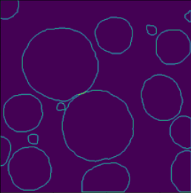
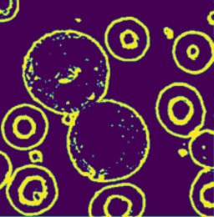
Holistic Nested Edge Detection
Image
Ground truth
Conv
2 layers
128 channels
P
O
O
L
Conv
3 layers
512 channels
P
O
O
L
Multi Size Weighted Fusion
Conv
2 layers
64 channels
P
O
O
L
Conv
3 layers
256 channels
P
O
O
L
Conv
3 layers
512 channels
P
O
O
L
Bi-Linear Deconvolute
Bi-Linear Deconvolute
4 Filter
4 Stride
Bi-Linear Deconvolute
8 Filter
6 Stride
Bi-Linear Deconvolute
16Filter
10 Stride
Bi-Linear Deconvolute
32 Filter
18 Stride
L
L
L
L
L
Predict y1
Predict y2
Predict y3
Predict y4
Predict y5
h1
h2
h3
h4
h5
Notes:
--bi linear deconv
1.) Xie, S. and Tu, Z. (2015) ‘Holistically-Nested Edge Detection’, arXiv:1504.06375 [cs]. Available at: http://arxiv.org/abs/1504.06375 (Accessed: 4 October 2020).

Slide 11
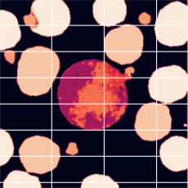
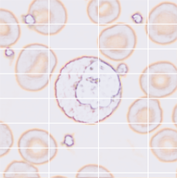
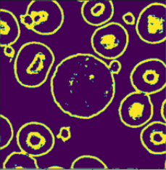
Integrated Architecture: SegNet + HED
Concatenate
SegNet
Prediction
HED
Input: Image
Notes:
1.) Marmanis, D. et al. (2018) ‘Classification with an edge: Improving semantic image segmentation with boundary detection’, ISPRS Journal of Photogrammetry and Remote Sensing, 135, pp. 158–172. doi: 10.1016/j.isprsjprs.2017.11.009.

Slide 12
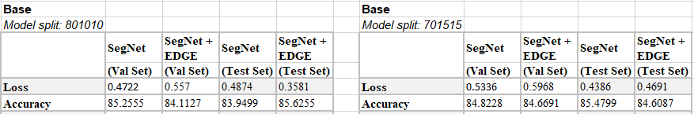
Initial Results
Notes:
Looks good – at first. But something is wrong.

Slide 13
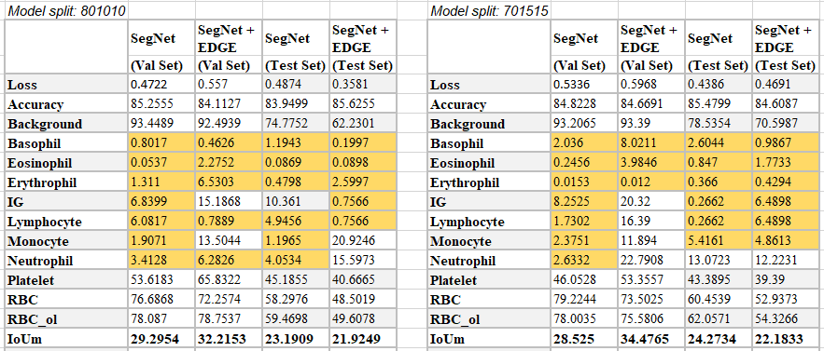
Initial Results
Notes:
Explain issue with using accuracy metric. Unbalanced image is influencing accuracy too much. IoU is a better metric.

Slide 14
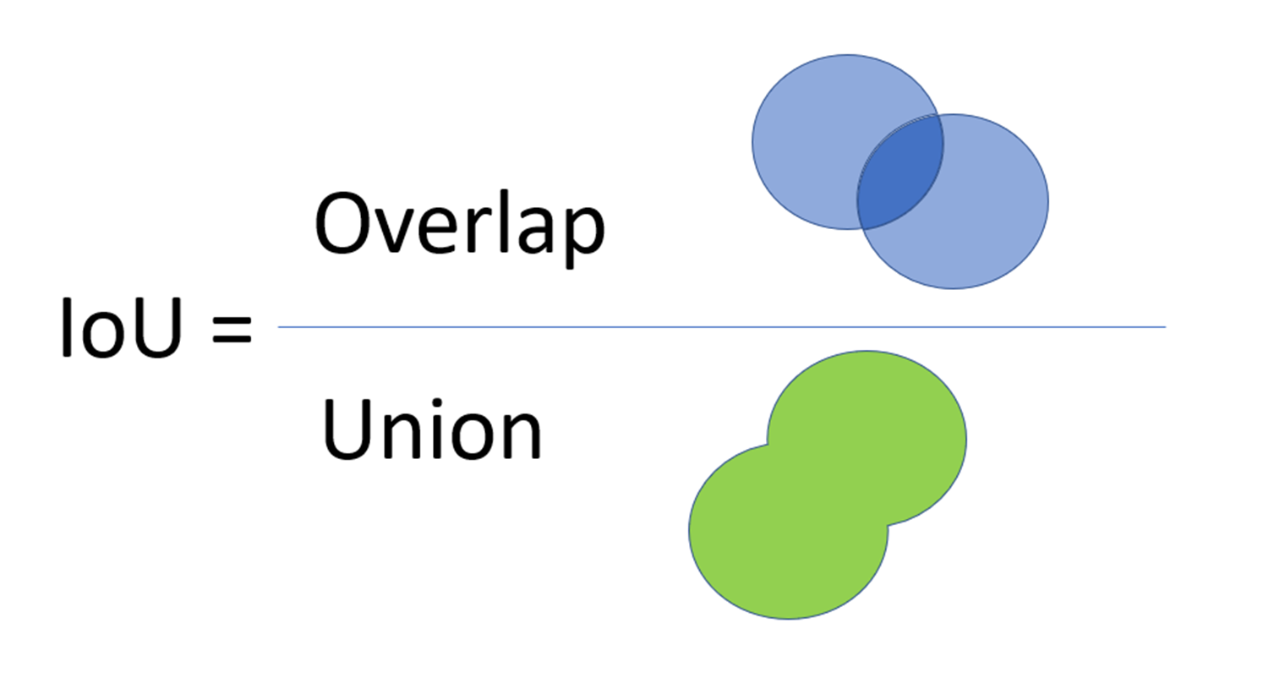
New Metrics
Notes:
Talk about accuracy and loss and then briefly mention why accuracy was not a great fit
Intersection over Union (IoU) (also known as the Jaccard index) - an evaluation metric used to measure the accuracy of an object detector on a particular dataset.
Tiu, E. (2020) Metrics to Evaluate your Semantic Segmentation Model, Medium. Available at: https://towardsdatascience.com/metrics-to-evaluate-your-semantic-segmentation-model-6bcb99639aa2 (Accessed: 4 May 2021).

Slide 15
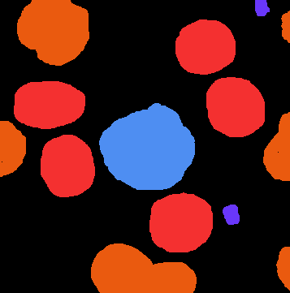
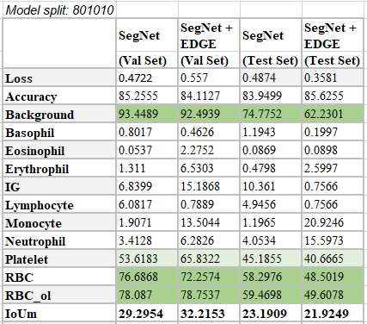
Initial Results
Notes:
Further explainations

Slide 16
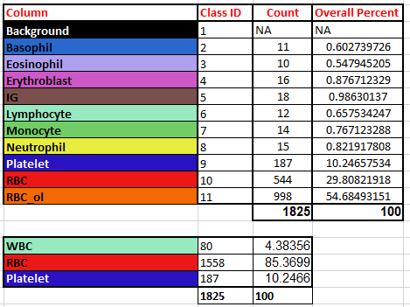
Class Breakdown

Slide 17
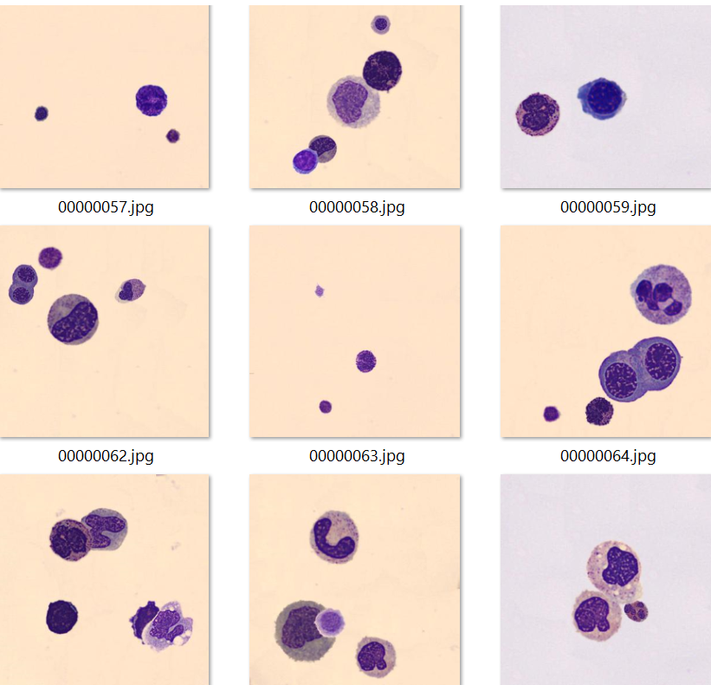
Synthetic Data
Notes:
Key decision
Adapted code from Immersion Software and took Kelly’s Udemy course.
Synthetic data was initially an aspirational goal, but became a requirement.

Slide 18
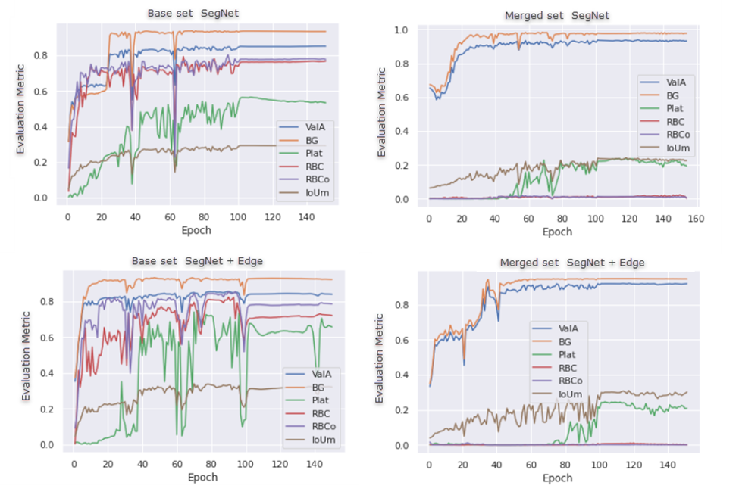
Results
Notes:
80/10/10 split
How accuracy is influenced by background.
inverse relationship for IoU percentage for RBC and RBC_ol.
smoother line after around 100 epochs, indicating this to be the target epoch.
Epoch – a pass of all the training set images through the neural network that is then used to tune the weights. Each number of an epoch represents the number of times the set has been passed through the network.

Slide 19
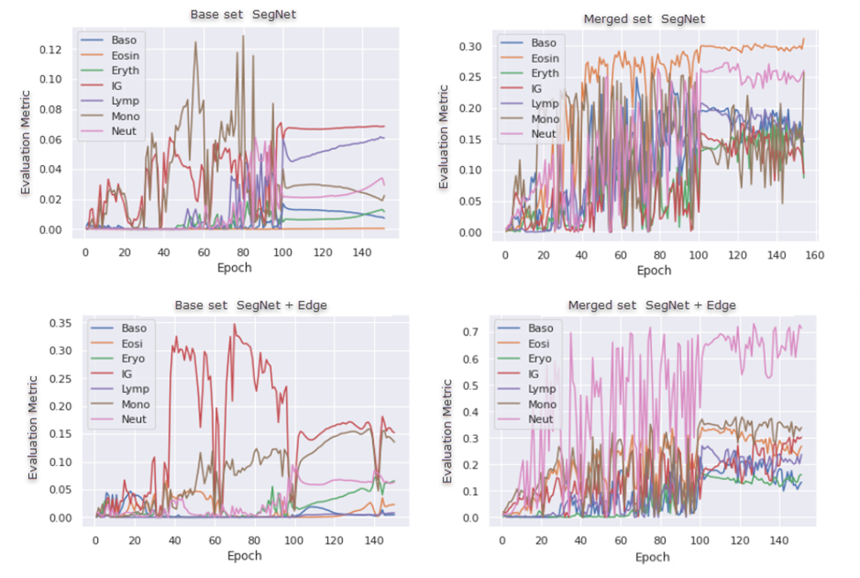
Results
Notes:
80/10/10 split
smoothing around the 100th epoch, though around the 120th epoch for the merged dataset, we begin to see some noise again and a downturn of several IoUs. This noise indicates that we may be beginning to overfit.
We notice on the syn side, higher IoU percentages.
All the classes show negligible results for the base dataset, though Immature Granulocytes has some remarkable variation in the SegNet + Edge model.
The merged dataset shows an increase in IoU across the board, with Neutrophil having a significant increase in the SegNet + Edge model.
Eosinophil in the merged dataset has a marked improvement from the base dataset but produces similar results between SegNet and SegNet + Edge.

Slide 20
Results
 | SegNet | SegNet + EDGE | SegNet | SegNet + EDGE
 | (Val Set) | (Val Set) | (Test Set) | (Test Set)
Loss | 0.2742 | 0.3889 | 0.2607 | 0.3341
Accuracy | 93.2704 | 91.9911 | 91.0738 | 91.8879
Background | 97.8084 | 94.6816 | 95.7375 | 94.2119
Basophil | 14.538 | 13.2722 | 8.9027 | 2.7757
Eosinophil | 31.2126 | 26.8891 | 43.2296 | 32.594
Erythrophil | 8.7142 | 16.1332 | 5.0236 | 14.6106
IG | 9.4065 | 30.2469 | 9.3827 | 17.7288
Lymphocyte | 14.7109 | 23.7224 | 9.3666 | 17.7288
Monocyte | 25.7398 | 33.9071 | 23.3619 | 31.7164
Neutrophil | 26.04875 | 71.4724 | 13.8273 | 44.5503
Platelet | 19.5127 | 20.8977 | 0.7278 | 15.2304
RBC | 0.3531 | 0.0955 | 0.4349 | 0.0475
RBC_ol | 0.5145 | 0.176 | 1.3301 | 0.0791
IoUm | 22.5963 | 30.1358 | 18.4702 | 24.3367
Adjusted Mean | 27.521317 | 36.802511 | 23.284411 | 30.127433
Notes:
If you are not prepared to be wrong, you will never come up with anything original.” - Sir Ken Robinson: TedTalk “Do schools kill creativity”

Slide 21
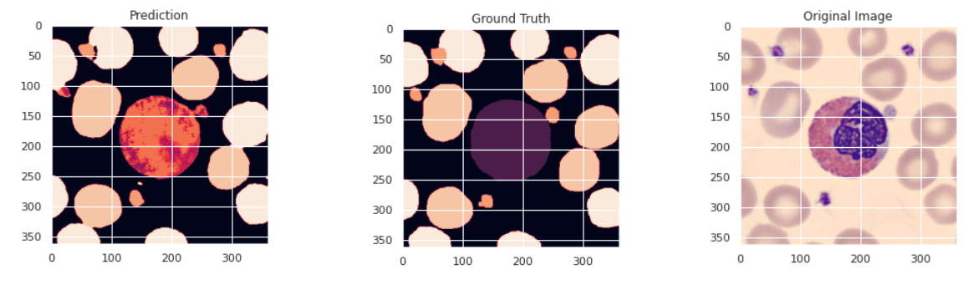
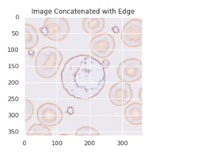
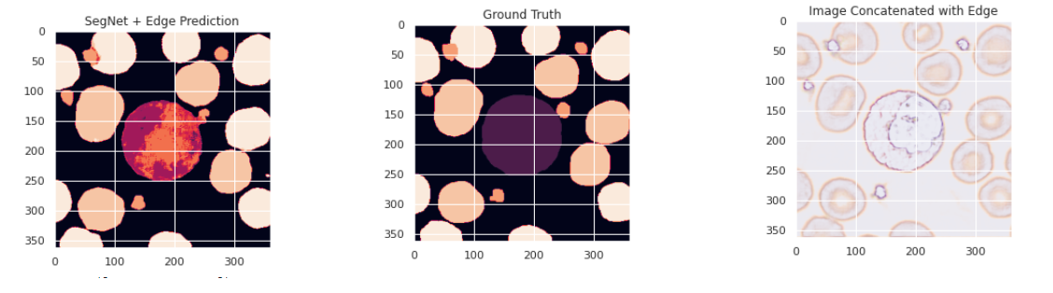
Predictions

Slide 22
Key decisions
Aspirational goals
RBCs
Model split decisions
Annotation
Notes:
Synthetic data set
RBCs
Removal of 60/20/20 model
annotation
Software
Removal of certain aspirational goals
annotate or find different dataset.
Annotate by software or by code.

Slide 23
Problems
Data cleansing
Annotations
Unbalanced classes
Image sizes
Not-plug and play

Slide 24
Adjustments and Changes
Synthetic dataset
Testing and retesting of different sets
Visualizing epoch images

Slide 25
Next Steps
Use
Use more foreground images
Increase
Increase dataset size
Shuffle
Shuffle synthetic dataset with base dataset
Limit
Set a limit for the amount an object can be obscured
Merge
Merge the RBC and RBC_ol group into one group
Add
Add all updates to GitHub

Slide 26
Future Work
Image Padding
Additional metrics
Neural Networks
Contour Images
Transfer learning
Notes:
Padding
Additional metrics: confusion matrix, mAP
Use different neural networks: ResNet or U-Net (HED replaced with REDN)
Test with the contour images as the fourth channel
Transfer learning and applying to other datasets
The UNET was developed by Olaf Ronneberger et al. for Bio Medical Image Segmentation. (towardsdatascience)
Unet uses requires less images and outperforms the prior best method (a sliding-window convolutional network) for segmentation of neuronal structures in electron microscopic stacks.
*1.) Lamba, H. (2019) Understanding Semantic Segmentation with UNET, Medium. Available at: https://towardsdatascience.com/understanding-semantic-segmentation-with-unet-6be4f42d4b47 (Accessed: 6 May 2021).
2.)Ronneberger, O., Fischer, P. and Brox, T. (2015) ‘U-Net: Convolutional Networks for Biomedical Image Segmentation’, arXiv:1505.04597 [cs]. Available at: http://arxiv.org/abs/1505.04597 (Accessed: 6 May 2021).
3.) LE, T. and DUAN, Y. (2020) ‘REDN: A Recursive Encoder-Decoder Network for Edge Detection’, IEEE access : practical innovations, open solutions, 8, pp. 90153–90164. doi: 10.1109/access.2020.2994160.

Slide 27
Knowledge Gained
Creation and Execution of a Data Science Project
Creating a synthetic dataset
Data cleaning with images
Notes:
Company asking: Business analytics – what does that mean?
Add about range.
When I first started the program I thought
Typically one does not think about computer vision with business any ….
Coursera, linkedIn
47 page report and 30 page slide deck while running more models with more ideas in the background during a global pandemic where everyday is chaos in our house.

Slide 28
Lessons Learned
Computer Vision needs lots of images
Balance does matter
Neural Networks are not plug and play
Notes:
Talk about lessons learned
How does this relate? Study is transferable (started with agriculture)

Slide 29
Master of Business Analytics
Teams, Projects, and Business Analytics Leadership
Business Analytics Foundation
Applied Statistical Modeling
Knowledge Discovery and Data Mining
Advanced Business Analytics
IT Strategy & Execution
Market Insights
Data Analytics and Visualization
Advanced Analytics Projects
Capstone Project
Notes:
Range of classes
How the items such as classification, data prepping, splits, project planning, debugging, unbalanced datasets, etc applies
First started, SQL was my main programming language, with a little bit of knowledge in others. Always thought in terms of sql. But now I don’t. I had to pull all my skills together to use r and python.

Slide 30
Knowledge is of no value unless you put it into practice—Anton Chekhov
Notes:
Full Circle to GH story
I’ve lead analytic teams project for major global health organizations.
And I saw a gap of leadership in myself and others for data analytics. You have people that are managers and people that are deep into the technology.
Sparse to have both.
With my Master of Business Analytics degree, I am now prepared to go back out and fill that gap. And help others to fulfill it as well.
Special thanks to Johann and Aliana for helping me with my dataset.

